Slide 1
Space and Time Tradeoffs

Slide 2
Space-for-time tradeoffs
Two varieties of space-for-time algorithms:
input enhancement — preprocess the input (or its part) to store some info to be used later in solving the problem
counting sorts
string searching algorithms
prestructuring — preprocess the input to make accessing its elements easier
hashing
indexing schemes (e.g., B-trees)

Slide 3
Review: String searching by brute force
pattern: a string of m characters to search for
text: a (long) string of n characters to search in
Brute force algorithm
Step 1 Align pattern at beginning of text
Step 2 Moving from left to right, compare each character of pattern to the corresponding character in text until either all characters are found to match (successful search) or a mismatch is detected
Step 3 While a mismatch is detected and the text is not yet exhausted, realign pattern one position to the right and repeat Step 2

Slide 4
String searching by preprocessing
Several string searching algorithms are based on the input
enhancement idea of preprocessing the pattern
Knuth-Morris-Pratt (KMP) algorithm preprocesses pattern left to right to get useful information for later searching
Boyer -Moore algorithm preprocesses pattern right to left and store information into two tables
Horspool’s algorithm simplifies the Boyer-Moore algorithm by using just one table

Slide 5
Horspool’s Algorithm
A simplified version of Boyer-Moore algorithm:
preprocesses pattern to generate a shift table that determines how much to shift the pattern when a mismatch occurs
always makes a shift based on the text’s character c aligned with the last character in the pattern according to the shift table’s entry for c

Slide 6
How far to shift?
Look at first (rightmost) character in text that was compared:
The character is not in the pattern
.....c...................... (c not in pattern)
BAOBAB
The character is in the pattern (but not the rightmost)
.....O...................... (O occurs once in pattern) BAOBAB
.....A...................... (A occurs twice in pattern)
BAOBAB
The rightmost characters do match
.....B......................
BAOBAB

Slide 7
Shift table
Shift sizes can be precomputed by the formula
distance from c’s rightmost occurrence in pattern among its first m-1 characters to its right end
t(c) =
pattern’s length m, otherwise
by scanning pattern before search begins and stored in a table called shift table
Shift table is indexed by text and pattern alphabet Eg, for BAOBAB:
A B C D E F G H I J K L M N O P Q R S T U V W X Y Z
1 2 6 6 6 6 6 6 6 6 6 6 6 6 3 6 6 6 6 6 6 6 6 6 6 6

Slide 8
Example of Horspool’s alg. application
A B C D E F G H I J K L M N O P Q R S T U V W X Y Z
_
BARD LOVED BANANAS
BAOBAB
BAOBAB
BAOBAB
BAOBAB (unsuccessful search)
1 2 6 6 6 6 6 6 6 6 6 6 6 6 3 6 6 6 6 6 6 6 6 6 6 6
6

Slide 9
Boyer-Moore algorithm
Based on same two ideas:
comparing pattern characters to text from right to left
precomputing shift sizes in two tables
bad-symbol table indicates how much to shift based on text’s character causing a mismatch
good-suffix table indicates how much to shift based on matched part (suffix) of the pattern

Slide 10
Bad-symbol shift in Boyer-Moore algorithm
If the rightmost character of the pattern doesn’t match, BM algorithm acts as Horspool’s
If the rightmost character of the pattern does match, BM compares preceding characters right to left until either all pattern’s characters match or a mismatch on text’s character c is encountered after k > 0 matches
text
pattern
bad-symbol shift d₁ = max{t₁(c ) - k, 1}
c
k matches

Slide 11
Good-suffix shift in Boyer-Moore algorithm
Good-suffix shift d₂ is applied after 0 < k < m last characters were matched
d₂(k) = the distance between matched suffix of size k and its rightmost occurrence in the pattern that is not preceded by the same character as the suffix Example: CABABA d₂(1) = 4
If there is no such occurrence, match the longest part of the k-character suffix with corresponding prefix; if there are no such suffix-prefix matches, d₂ (k) = m Example: WOWWOW d₂(2) = 5, d₂(3) = 3, d₂(4) = 3, d₂(5) = 3

Slide 12
Good-suffix shift in the Boyer-Moore alg. (cont.)
After matching successfully 0 < k < m characters, the algorithm shifts the pattern right by
d = max {d₁, d₂}
where d₁ = max{t₁(c) - k, 1} is bad-symbol shift
d₂(k) is good-suffix shift

Slide 13
Boyer-Moore Algorithm (cont.)
Step 1 Fill in the bad-symbol shift table
Step 2 Fill in the good-suffix shift table
Step 3 Align the pattern against the beginning of the text
Step 4 Repeat until a matching substring is found or text ends:
Compare the corresponding characters right to left.
If no characters match, retrieve entry t₁(c) from the bad-symbol table for the text’s character c causing the mismatch and shift the pattern to the right by t₁(c). If 0 < k < m characters are matched, retrieve entry t₁(c) from the bad-symbol table for the text’s character c causing the mismatch and entry d₂(k) from the good-suffix table and shift the pattern to the right by
d = max {d₁, d₂} where d₁ = max{t₁(c) - k, 1}.

Slide 14
Example of Boyer-Moore alg. application
A B C D E F G H I J K L M N O P Q R S T U V W X Y Z
_
B E S S _ K N E W _ A B O U T _ B A O B A B S
B A O B A B
d₁ = t₁(K) = 6 B A O B A B
d₁ = t₁(_)-2 = 4
d₂(2) = 5
B A O B A B
d₁ = t₁(_)-1 = 5
d₂(1) = 2
B A O B A B (success)
1 2 6 6 6 6 6 6 6 6 6 6 6 6 3 6 6 6 6 6 6 6 6 6 6 6
6
k | pattern | d₂
1 | BAOBAB | 2
2 | BAOBAB | 5
3 | BAOBAB | 5
4 | BAOBAB | 5
5 | BAOBAB | 5

Slide 15
Boyer-Moore example from their paper
Find pattern AT_THAT in
WHICH_FINALLY_HALTS. _ _ AT_THAT

Slide 16
Hashing
A very efficient method for implementing a dictionary, i.e., a set with the operations:
find
insert
delete
Based on representation-change and space-for-time tradeoff ideas
Important applications:
symbol tables
databases (extendible hashing)

Slide 17
Hash tables and hash functions
The idea of hashing is to map keys of a given file of size n into
a table of size m, called the hash table, by using a predefined
function, called the hash function,
h: K → location (cell) in the hash table
Example: student records, key = SSN. Hash function:
h(K) = K mod m where m is some integer (typically, prime)
Generally, a hash function should:
be easy to compute
distribute keys about evenly throughout the hash table

Slide 18
Collisions
If h(K₁) = h(K₂), there is a collision
Good hash functions result in fewer collisions but some collisions should be expected (birthday paradox)
Two principal hashing schemes handle collisions differently:
Open hashing – each cell is a header of linked list of all keys hashed to it
Closed hashing
one key per cell
in case of collision, finds another cell by
linear probing: use next free bucket
double hashing: use second hash function to compute increment

Slide 19
Open hashing (Separate chaining)
Keys are stored in linked lists outside a hash table whose
elements serve as the lists’ headers.
Example: A, FOOL, AND, HIS, MONEY, ARE, SOON, PARTED
h(K) = sum of K ‘s letters’ positions in the alphabet MOD 13
Key | A | FOOL | AND | HIS | MONEY | ARE | SOON | PARTED
h(K) | 1 | 9 | 6 | 10 | 7 | 11 | 11 | 12
0
1
2
3
4
5
6
7
8
9
10
11
12
A
AND
MONEY
FOOL
HIS
ARE
PARTED
SOON

Slide 20
Open hashing (cont.)
If hash function distributes keys uniformly, average length of linked list will be α = n/m. This ratio is called load factor.
Average number of probes in successful, S, and unsuccessful searches, U:
S ≈ 1+α/2, U = α
Load α is typically kept small (ideally, about 1)
Open hashing still works if n > m

Slide 21
Closed hashing (Open addressing)
Keys are stored inside a hash table.
Key | A | FOOL | AND | HIS | MONEY | ARE | SOON | PARTED
h(K) | 1 | 9 | 6 | 10 | 7 | 11 | 11 | 12
0
1
2
3
4
5
6
7
8
9
10
11
12
 | A
 | A |  |  |  |  |  |  |  | FOOL
 | A |  |  |  |  | AND |  |  | FOOL
 | A |  |  |  |  | AND |  |  | FOOL | HIS
 | A |  |  |  |  | AND | MONEY |  | FOOL | HIS
 | A |  |  |  |  | AND | MONEY |  | FOOL | HIS | ARE
 | A |  |  |  |  | AND | MONEY |  | FOOL | HIS | ARE | SOON
PARTED | A |  |  |  |  | AND | MONEY |  | FOOL | HIS | ARE | SOON

Slide 22
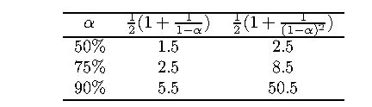
Closed hashing (cont.)
Does not work if n > m
Avoids pointers
Deletions are not straightforward
Number of probes to find/insert/delete a key depends on load factor α = n/m (hash table density) and collision resolution strategy. For linear probing:
S = (½) (1+ 1/(1- α)) and U = (½) (1+ 1/(1- α)²)
As the table gets filled (α approaches 1), number of probes in linear probing increases dramatically:

Slide 23
Iterative Improvement
Algorithm design technique for solving optimization problems
Start with a feasible solution
Repeat the following step until no improvement can be found:
change the current feasible solution to a feasible solution with a better value of the objective function
Return the last feasible solution as optimal
Note: Typically, a change in a current solution is “small” (local search)
Major difficulty: Local optimum vs. global optimum
Notes:
These were discussed in the first lecture. At this point, the claims made then about
“efficient” algorithms can be discussed in more concrete terms.
Before launching into this lecture, I usually read to my students the introductory whimsical
example from Garey and Johnson “Computers and Intractability”, while showing
overhead transparencies of their cartoons. These are not reproduced here because it would
require copyright clearance.

Slide 24
Important Examples
simplex method
Ford-Fulkerson algorithm for maximum flow problem
maximum matching of graph vertices
Gale-Shapley algorithm for the stable marriage problem
local search heuristics

Slide 25
Linear Programming
Linear programming (LP) problem is to optimize a linear function of several variables subject to linear constraints:
maximize (or minimize) c₁ x₁ + ...+ c_{n} x_{n}
subject to a_{i 1}x₁+ ...+ a_{in} x_{n} ≤ (or ≥ or =) b_{i} , i = 1,...,m x₁ ≥ 0, ... , x_{n} ≥ 0
The function z = c₁ x₁ + ...+ c_{n} x_{n} is called the objective function;
constraints x₁ ≥ 0, ... , x_{n} ≥ 0 are called nonnegativity constraints

Slide 26
Example
maximize 3x + 5y
subject to x + y ≤ 4
x + 3y ≤ 6
x ≥ 0, y ≥ 0
Feasible region is the set of points defined by the constraints

Slide 27
Geometric solution
maximize 3x + 5y
subject to x + y ≤ 4
x + 3y ≤ 6
x ≥ 0, y ≥ 0
Optimal solution: x = 3, y = 1
Extreme Point Theorem Any LP problem with a nonempty bounded feasible region has an optimal solution; moreover, an optimal solution can always be found at an extreme point of the problem's feasible region.

Slide 28
3 possible outcomes in solving an LP problem
has a finite optimal solution, which may no be unique
unbounded: the objective function of maximization (minimization) LP problem is unbounded from above (below) on its feasible region
infeasible: there are no points satisfying all the constraints, i.e. the constraints are contradictory

Slide 29
The Simplex Method
The classic method for solving LP problems; one of the most important algorithms ever invented
Invented by George Dantzig in 1947
Based on the iterative improvement idea:
Generates a sequence of adjacent points of the problem’s feasible region with improving values of the objective function until no further improvement is possible

Slide 30
Standard form of LP problem
must be a maximization problem
all constraints (except the nonnegativity constraints) must be in the form of linear equations
all the variables must be required to be nonnegative
Thus, the general linear programming problem in standard
form with m constraints and n unknowns (n ≥ m) is
maximize c₁ x₁ + ...+ c_{n} x_{n}
subject to a_{i 1}x₁+ ...+ a_{in} x_{n} = b_{i} , i = 1,...,m, x₁ ≥ 0, ... , x_{n} ≥ 0
Every LP problem can be represented in such form

Slide 31
Example
maximize 3x + 5y maximize 3x + 5y + 0u + 0v
subject to x + y ≤ 4 subject to x + y + u = 4
x + 3y ≤ 6 x + 3y + v = 6
x≥0, y≥0 x≥0, y≥0, u≥0, v≥0
Variables u and v, transforming inequality constraints into
equality constrains, are called slack variables

Slide 32
Basic feasible solutions
A basic solution to a system of m linear equations in n unknowns (n ≥ m) is obtained by setting n – m variables to 0 and solving the resulting system to get the values of the other m variables. The variables set to 0 are called nonbasic; the variables obtained by solving the system are called basic.
A basic solution is called feasible if all its (basic) variables are nonnegative.
Example x + y + u = 4
x + 3y + v = 6
(0, 0, 4, 6) is basic feasible solution
(x, y are nonbasic; u, v are basic)
There is a 1-1 correspondence between extreme points of LP’s feasible region and its basic feasible solutions.

Slide 33
Simplex Tableau
maximize z = 3x + 5y + 0u + 0v
subject to x + y + u = 4
x + 3y + v = 6
x≥0, y≥0, u≥0, v≥0
basic feasible solution
(0, 0, 4, 6)
basic variables
objective row
value of z at (0, 0, 4, 6)

Slide 34
Outline of the Simplex Method
Step 0 [Initialization] Present a given LP problem in standard form and set up initial tableau.
Step 1 [Optimality test] If all entries in the objective row are nonnegative — stop: the tableau represents an optimal solution.
Step 2 [Find entering variable] Select (the most) negative entry in the objective row. Mark its column to indicate the entering variable and the pivot column.
Step 3 [Find departing variable] For each positive entry in the pivot column, calculate the θ-ratio by dividing that row's entry in the rightmost column by its entry in the pivot column. (If there are no positive entries in the pivot column — stop: the problem is unbounded.) Find the row with the smallest θ-ratio, mark this row to indicate the departing variable and the pivot row.
Step 4 [Form the next tableau] Divide all the entries in the pivot row by its entry in the pivot column. Subtract from each of the other rows, including the objective row, the new pivot row multiplied by the entry in the pivot column of the row in question. Replace the label of the pivot row by the variable's name of the pivot column and go back to Step 1.

Slide 35
Example of Simplex Method Application
maximize z = 3x + 5y + 0u + 0v
subject to x + y + u = 4
x + 3y + v = 6
x≥0, y≥0, u≥0, v≥0
maximize z = 3x + 5y + 0u + 0v
subject to x + y + u = 4
x + 3y + v = 6
x≥0, y≥0, u≥0, v≥0
basic feasible sol. (0, 0, 4, 6)
z = 0
basic feasible sol. (0, 2, 2, 0)
z = 10
basic feasible sol. (3, 1, 0, 0)
z = 14

Slide 36
Notes on the Simplex Method
Finding an initial basic feasible solution may pose a problem
Theoretical possibility of cycling
Typical number of iterations is between m and 3m, where m is the number of equality constraints in the standard form
Worse-case efficiency is exponential
More recent interior-point algorithms such as Karmarkar’s algorithm (1984) have polynomial worst-case efficiency and have performed competitively with the simplex method in empirical tests

Slide 37
Maximum Flow Problem
Problem of maximizing the flow of a material through a transportation network (e.g., pipeline system, communications or transportation networks)
Formally represented by a connected weighted digraph with n vertices numbered from 1 to n with the following properties:
contains exactly one vertex with no entering edges, called the source (numbered 1)
contains exactly one vertex with no leaving edges, called the sink (numbered n)
has positive integer weight u_{ij} on each directed edge (i.j), called the edge capacity, indicating the upper bound on the amount of the material that can be sent from i to j through this edge

Slide 38
Example of Flow Network
5
4
3
Source
2
5
2
1
2
3
6
3
Sink
1
4

Slide 39
Definition of a Flow
A flow is an assignment of real numbers x_{ij} to edges (i,j) of a given network that satisfy the following:
flow-conservation requirements The total amount of material entering an intermediate vertex must be equal to the total amount of the material leaving the vertex
capacity constraints
0 ≤ x_{ij} ≤ u_{ij} for every edge (i,j) ∈ E
∑ x_{ji} = ∑ x_{ij} for i = 2,3,…, n-1
j: (j,i) є E j: (i,j) є E

Slide 40
Flow value and Maximum Flow Problem
Since no material can be lost or added to by going through intermediate vertices of the network, the total amount of the material leaving the source must end up at the sink:
∑ x_{1j} = ∑ x_{jn}
The value of the flow is defined as the total outflow from the source (= the total inflow into the sink).
The maximum flow problem is to find a flow of the largest value (maximum flow) for a given network.
j: (1,j) є E j: (j,n) є E

Slide 41
Maximum-Flow Problem as LP problem
Maximize v = ∑ x_{1j}
j: (1,j) ∈ E
subject to
∑ x_{ji} - ∑ x_{ij} = 0 for i = 2, 3,…,n-1
j: (j,i) ∈ E j: (i,j) ∈ E
0 ≤ x_{ij} ≤ u_{ij} for every edge (i,j) ∈ E

Slide 42
Augmenting Path (Ford-Fulkerson) Method
Start with the zero flow (x_{ij} = 0 for every edge)
On each iteration, try to find a flow-augmenting path from source to sink, which a path along which some additional flow can be sent
If a flow-augmenting path is found, adjust the flow along the edges of this path to get a flow of increased value and try again
If no flow-augmenting path is found, the current flow is maximum

Slide 43
Example 1
5
0/3
0/4
0/2
0/5
0/2
1
2
3
6
0/3
0/1
x_{ij}/u_{ij}
4
Augmenting path:
1→2 →3 →6

Slide 44
Example 1 (cont.)
5
0/3
0/4
2/2
2/5
2/2
1
2
3
6
0/3
0/1
4
Augmenting path:
1 →4 →3←2 →5 →6

Slide 45
Example 1 (maximum flow)
5
1/3
1/4
2/2
1/5
2/2
1
2
3
6
1/3
1/1
max flow value = 3
4

Slide 46
Finding a flow-augmenting path
To find a flow-augmenting path for a flow x, consider paths from source to sink in the underlying undirected graph in which any two consecutive vertices i,j are either:
connected by a directed edge (i to j) with some positive unused capacity r_{ij} = u_{ij} – x_{ij}
known as forward edge ( → )
OR
connected by a directed edge (j to i) with positive flow x_{ji}
known as backward edge ( ← )
If a flow-augmenting path is found, the current flow can be increased by r units by increasing x_{ij} by r on each forward edge and decreasing x_{ji} by r on each backward edge, where r = min {r_{ij} on all forward edges, x_{ji} on all backward edges}

Slide 47
Finding a flow-augmenting path (cont.)
Assuming the edge capacities are integers, r is a positive integer
On each iteration, the flow value increases by at least 1
Maximum value is bounded by the sum of the capacities of the edges leaving the source; hence the augmenting-path method has to stop after a finite number of iterations
The final flow is always maximum, its value doesn’t depend on a sequence of augmenting paths used

Slide 48
Performance degeneration of the method
The augmenting-path method doesn’t prescribe a specific way for generating flow-augmenting paths
Selecting a bad sequence of augmenting paths could impact the method’s efficiency
Example 2
2
0/U
0/U
1
0/1
3
U = large positive integer
0/U
0/U
4

Slide 49
Example 2 (cont.)
2
2
0/U
0/U
1/U
0/U
1
0/1
3
1
1/1
3
V=1
0/U
0/U
0/U
1/U
1→2→4→3
4
4
1→4←2→3
2
2
U/U
U/U
1/U
1/U
V=2U
1
0/1
3
● ● ●
1
0/1
3
V=2
U/U
U/U
1/U
1/U
4
4
Requires 2U iterations to reach maximum flow of value 2U

Slide 50
Shortest-Augmenting-Path Algorithm
Generate augmenting path with the least number of edges by BFS as follows.
Starting at the source, perform BFS traversal by marking new (unlabeled) vertices with two labels:
first label – indicates the amount of additional flow that can be brought from the source to the vertex being labeled
second label – indicates the vertex from which the vertex being labeled was reached, with “+” or “–” added to the second label to indicate whether the vertex was reached via a forward or backward edge

Slide 51
Vertex labeling
The source is always labeled with ∞,-
All other vertices are labeled as follows:
If unlabeled vertex j is connected to the front vertex i of the traversal queue by a directed edge from i to j with positive unused capacity r_{ij} = u_{ij} –x_{ij} (forward edge), vertex j is labeled with l_{j},i⁺, where l_{j} = min{l_{i}, r_{ij}}
If unlabeled vertex j is connected to the front vertex i of the traversal queue by a directed edge from j to i with positive flow x_{ji} (backward edge), vertex j is labeled l_{j},i⁻, where l_{j} = min{l_{i}, x_{ji}}

Slide 52
Vertex labeling (cont.)
If the sink ends up being labeled, the current flow can be augmented by the amount indicated by the sink’s first label
The augmentation of the current flow is performed along the augmenting path traced by following the vertex second labels from sink to source; the current flow quantities are increased on the forward edges and decreased on the backward edges of this path
If the sink remains unlabeled after the traversal queue becomes empty, the algorithm returns the current flow as maximum and stops

Slide 53
Example: Shortest-Augmenting-Path Algorithm
5
0/3
0/4
0/2
0/5
0/2
1
2
3
6
2,2⁺
0/3
0/1
5
4
0/3
0/4
∞,-
2,1⁺
2,3⁺
Queue: 1 2 4 3 5 6
↑ ↑ ↑ ↑
0/2
0/5
0/2
1
2
3
6
2,2⁺
0/3
0/1
4
3,1⁺
Augment the flow by 2 (the sink’s first label) along the path 1→2→3→6

Slide 54
Example (cont.)
5
0/3
0/4
2/2
2/5
2/2
1
2
3
6
1,2⁺
0/3
0/1
5
4
0/3
0/4
Queue: 1 4 3 2 5 6
↑ ↑ ↑ ↑ ↑
∞,-
1,3⁻
1,5⁺
2/2
2/5
2/2
1
2
3
6
1,4⁺
0/3
0/1
4
3,1⁺
Augment the flow by 1 (the sink’s first label) along the path 1→4→3←2→5→6

Slide 55
Example (cont.)
5
1/3
1/4
2/2
1/5
2/2
1
2
3
6
1/3
1/1
5
4
1/3
1/4
Queue: 1 4
↑ ↑
∞,-
2/2
1/5
2/2
1
2
3
6
1/3
1/1
4
2,1⁺
No augmenting path (the sink is unlabeled) the current flow is maximum

Slide 56
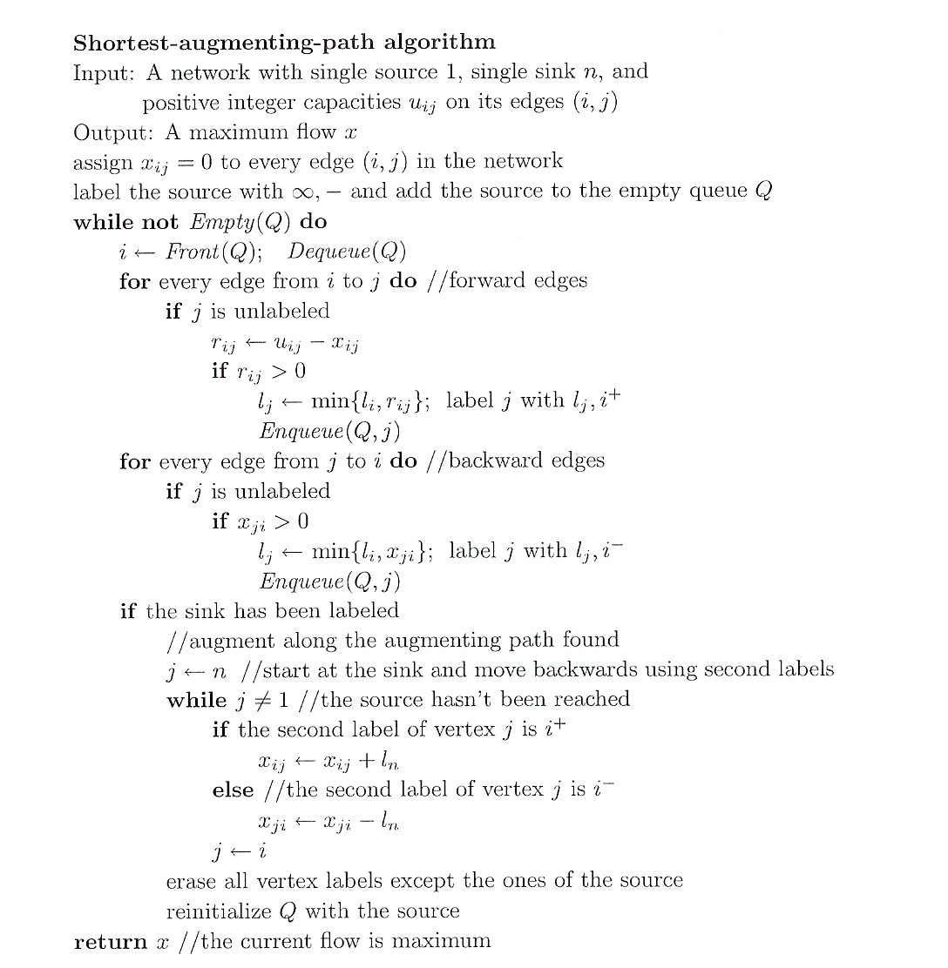

Slide 57
Time Efficiency
The number of augmenting paths needed by the shortest-augmenting-path algorithm never exceeds nm/2, where n and m are the number of vertices and edges, respectively
Since the time required to find shortest augmenting path by breadth-first search is in O(n+m)=O(m) for networks represented by their adjacency lists, the time efficiency of the shortest-augmenting-path algorithm is in O(nm²) for this representation
More efficient algorithms have been found that can run in close to O(nm) time, but these algorithms don’t fall into the iterative-improvement paradigm

Slide 58
Definition of a Cut
Let X be a set of vertices in a network that includes its source but does not include its sink, and let X, the complement of X, be the rest of the vertices including the sink. The cut induced by this partition of the vertices is the set of all the edges with a tail in X and a head in X.
Capacity of a cut is defined as the sum of capacities of the edges that compose the cut.
We’ll denote a cut and its capacity by C(X,X) and c(X,X)
Note that if all the edges of a cut were deleted from the network, there would be no directed path from source to sink
Minimum cut is a cut of the smallest capacity in a given network

Slide 59
Examples of network cuts
5
3
4
1
2
2
5
3
2
6
3
1
4
If X = {1} and X = {2,3,4,5,6}, C(X,X) = {(1,2), (1,4)}, c = 5
If X ={1,2,3,4,5} and X = {6}, C(X,X) = {(3,6), (5,6)}, c = 6
If X = {1,2,4} and X ={3,5,6}, C(X,X) = {(2,3), (2,5), (4,3)}, c = 9

Slide 60
Max-Flow Min-Cut Theorem
The value of maximum flow in a network is equal to the capacity of its minimum cut
The shortest augmenting path algorithm yields both a maximum flow and a minimum cut:
maximum flow is the final flow produced by the algorithm
minimum cut is formed by all the edges from the labeled vertices to unlabeled vertices on the last iteration of the algorithm
all the edges from the labeled to unlabeled vertices are full, i.e., their flow amounts are equal to the edge capacities, while all the edges from the unlabeled to labeled vertices, if any, have zero flow amounts on them

Slide 61
Stable Marriage Problem
There is a set Y = {m₁,…,m_{n}} of n men and a set X = {w₁,…,w_{n}} of n women. Each man has a ranking list of the women, and each woman has a ranking list of the men (with no ties in these lists).
A marriage matching M is a set of n pairs (m_{i}, w_{j}).
A pair (m, w) is said to be a blocking pair for matching M if man m and woman w are not matched in M but prefer each other to their mates in M.
A marriage matching M is called stable if there is no blocking pair for it; otherwise, it’s called unstable.
The stable marriage problem is to find a stable marriage matching for men’s and women’s given preferences.

Slide 62
Instance of the Stable Marriage Problem
An instance of the stable marriage problem can be specified either by two sets of preference lists or by a ranking matrix, as in the example below.
men’s preferences women’s preferences
1st 2nd 3rd 1st 2nd 3rd
Bob: Lea Ann Sue Ann: Jim Tom Bob
Jim: Lea Sue Ann Lea: Tom Bob Jim
Tom: Sue Lea Ann Sue: Jim Tom Bob
ranking matrix
Ann Lea Sue
Bob 2,3 1,2 3,3
Jim 3,1 1,3 2,1
Tom 3,2 2,1 1,2
{(Bob, Ann) (Jim, Lea) (Tom, Sue)} is unstable
{(Bob, Ann) (Jim, Sue) (Tom, Lea)} is stable

Slide 63
Stable Marriage Algorithm (Gale-Shapley)
Step 0 Start with all the men and women being free
Step 1 While there are free men, arbitrarily select one of them and do the following: Proposal The selected free man m proposes to w, the next woman on his preference list
Response If w is free, she accepts the proposal to be matched with m. If she is not free, she compares m with her current mate. If she prefers m to him, she accepts m’s proposal, making her former mate free; otherwise, she simply rejects m’s proposal, leaving m free
Step 2 Return the set of n matched pairs

Slide 64
Example
 | Ann | Lea | Sue
Bob | 2,3 | 1,2 | 3,3
Jim | 3,1 | 1,3 | 2,1
Tom | 3,2 | 2,1 | 1,2
Free men: Bob, Jim, Tom
Bob proposed to Lea Lea accepted
 | Ann | Lea | Sue
Bob | 2,3 | 1,2 | 3,3
Jim | 3,1 | 1,3 | 2,1
Tom | 3,2 | 2,1 | 1,2
Free men: Jim, Tom
Jim proposed to Lea Lea rejected

Slide 65
Example (cont.)
 | Ann | Lea | Sue
Bob | 2,3 | 1,2 | 3,3
Jim | 3,1 | 1,3 | 2,1
Tom | 3,2 | 2,1 | 1,2
Free men: Jim, Tom
Jim proposed to Sue Sue accepted
 | Ann | Lea | Sue
Bob | 2,3 | 1,2 | 3,3
Jim | 3,1 | 1,3 | 2,1
Tom | 3,2 | 2,1 | 1,2
Free men: Tom
Tom proposed to Sue Sue rejected

Slide 66
Example (cont.)
 | Ann | Lea | Sue
Bob | 2,3 | 1,2 | 3,3
Jim | 3,1 | 1,3 | 2,1
Tom | 3,2 | 2,1 | 1,2
Free men: Tom
Tom proposed to Lea Lea replaced Bob with Tom
 | Ann | Lea | Sue
Bob | 2,3 | 1,2 | 3,3
Jim | 3,1 | 1,3 | 2,1
Tom | 3,2 | 2,1 | 1,2
Free men: Bob
Bob proposed to Ann Ann accepted

Slide 67
Analysis of the Gale-Shapley Algorithm
The algorithm terminates after no more than n² iterations with a stable marriage output
The stable matching produced by the algorithm is always man-optimal: each man gets the highest rank woman on his list under any stable marriage. One can obtain the woman-optimal matching by making women propose to men
A man (woman) optimal matching is unique for a given set of participant preferences
The stable marriage problem has practical applications such as matching medical-school graduates with hospitals for residency training

